Slide 1
Construction Industry: Productivity and Safety
ABS and Safe Work Australia data
Prepared by the Administrator of the CFMEU for use in cross-examination
Commission of Inquiry into the CFMEU and Misconduct in the Construction Industry

Slide 2
Construction industry regulation: key dates
Date | Event
1 October 2002 | Interim Building Industry Taskforce (IBIT) established — Hadgkiss head
March 2004 | Building Industry Taskforce (BIT) established — Hadgkiss head
1 October 2005 | Australian Building and Construction Commission (ABCC) established — Lloyd Commissioner, Hadgkiss Deputy Commissioner
11 October 2010 | Johns appointed Commissioner of ABCC
March 2012 – October 2013 | Hadgkiss Director, Victorian CCCU (Victorian Code drafted in this period)
1 June 2012 | Fair Work Building and Construction Inspectorate (FWBC) established — Johns acting director
21 October 2013 | Hadgkiss appointed Director of FWBC
2 December 2016 | ABCC re-established — Hadgkiss Commissioner
13 September 2017 | Hadgkiss resigned
September 2017 – February 2023 | ABCC continued under successors (McBurney from February 2018)
6 February 2023 | ABCC abolished

Slide 3
Labour Productivity

Slide 4
Labour productivity, Construction industry (E), 2005-06 to 2024-25
ABS Catalogue 5260.0.55.002, Table 6 (quality adjusted hours worked basis)
Year | Index
2005-06 | 106.74
2006-07 | 100.90
2007-08 | 100.04
2008-09 | 101.70
2009-10 | 104.87
2010-11 | 102.51
2011-12 | 112.43
2012-13 | 118.16
2013-14 | 123.36
2014-15 | 113.88
Year | Index
2015-16 | 108.85
2016-17 | 107.37
2017-18 | 108.97
2018-19 | 104.07
2019-20 | 103.57
2020-21 | 104.31
2021-22 | 102.51
2022-23 | 99.15
2023-24 | 100.00
2024-25 | 97.07
Labour productivity (ABS):
"Labour productivity is defined as a ratio of output to labour input, that is, the amount of output produced for an hour of work."
Source: ABS, Estimates of Industry Multifactor Productivity methodology, 2024-25.
Quality adjusted hours worked basis (QALI):
"The ABS compiles a quality adjusted labour input (QALI) measure which captures changes in hours worked and in labour composition. Changes in labour composition such as changes in educational achievement and experience are sourced from the Census of Population and Housing..."
Source: ABS, Estimates of Industry Multifactor Productivity methodology, 2024-25.
Source of data: Australian Bureau of Statistics
5260.0.55.002 Estimates of Industry Multifactor Productivity, Australia
Table 6: Labour Productivity Indexes (a) (b)

Slide 5
Labour productivity, construction industry
Peak (2013-14) → last full year of ABCC (2022-23)
123.36
→
99.15
2013-14
2022-23
A decline of around 20 per cent across nine years

Slide 6
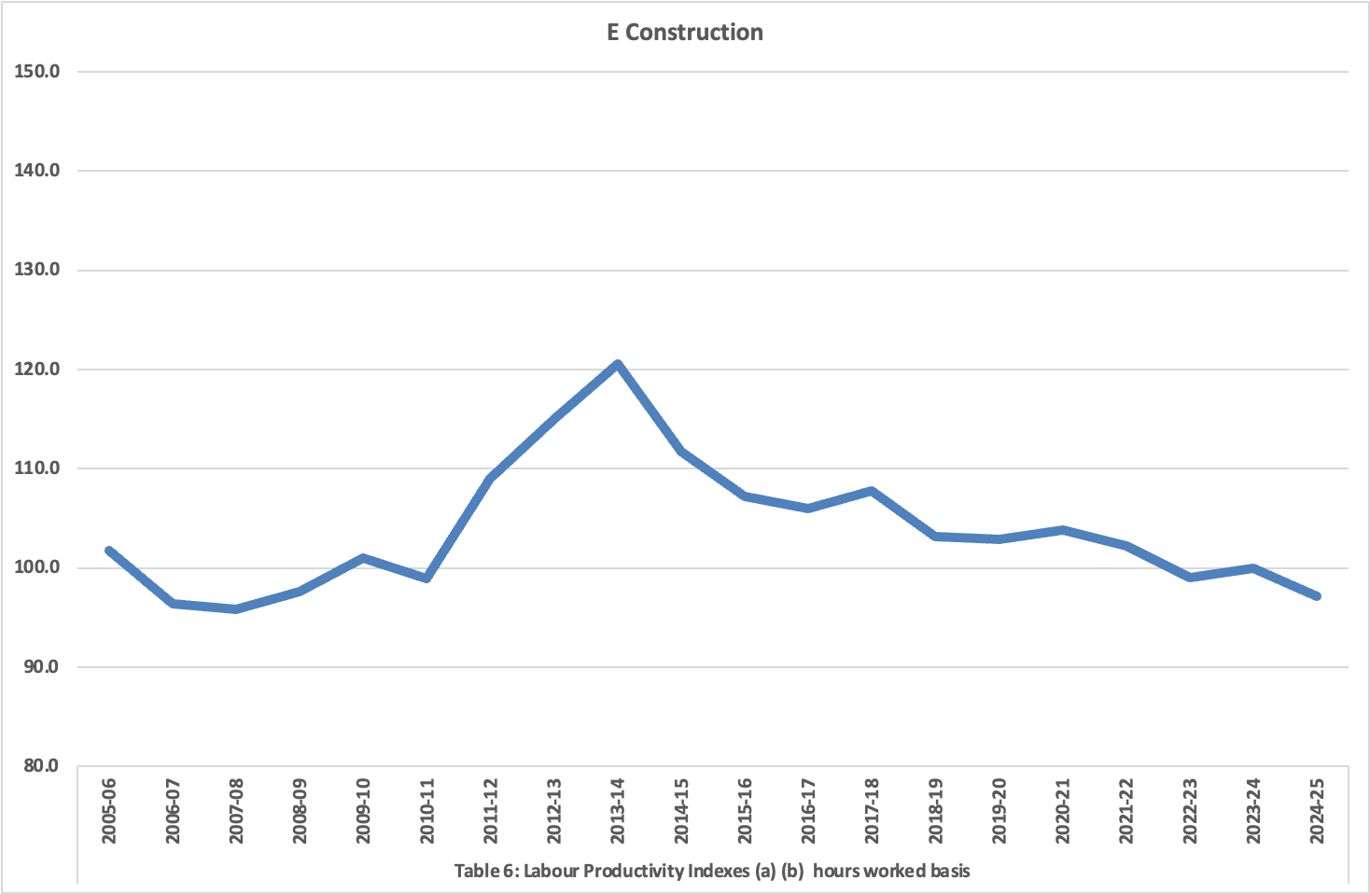
Labour productivity, Construction industry, 2005-06 to 2024-25
Source of data: Australian Bureau of Statistics
5260.0.55.002 Estimates of Industry Multifactor Productivity, Australia
Table 6: Labour Productivity Indexes (a) (b)

Slide 7
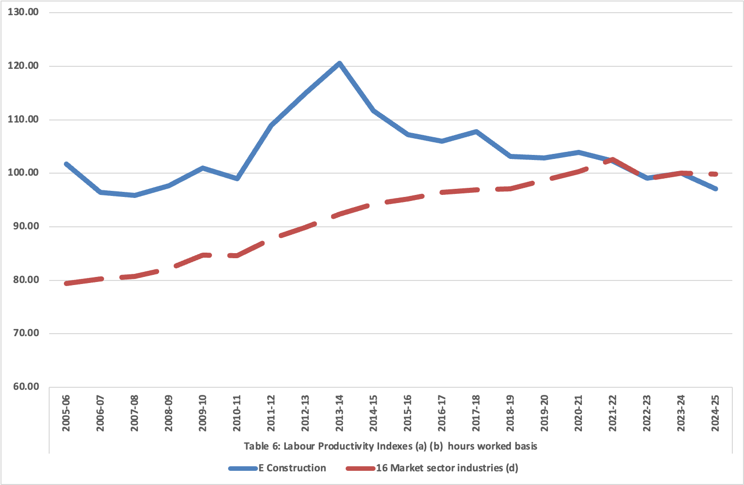
Labour productivity: Construction v 16 Market sector industries, 2005-06 to 2024-25
Source of data: Australian Bureau of Statistics
5260.0.55.002 Estimates of Industry Multifactor Productivity, Australia
Table 6: Labour Productivity Indexes (a) (b)

Slide 8
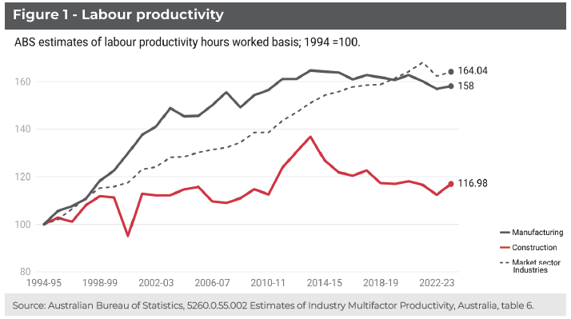
Source: Melissa Wilson & James Brooks, ‘Size Matters, Why Construction Productivity is So Weak’, Committee for the Economic Development of Australia (CEDA), presented at joint Australian Bureau of Statistics & Reserve Bank of Australia conference, Opening Doors: Data and Analytics Shedding Light on Housing Challenges, Sydney, 23–24 June 2025, p 6

Slide 9
Capital Productivity

Slide 10
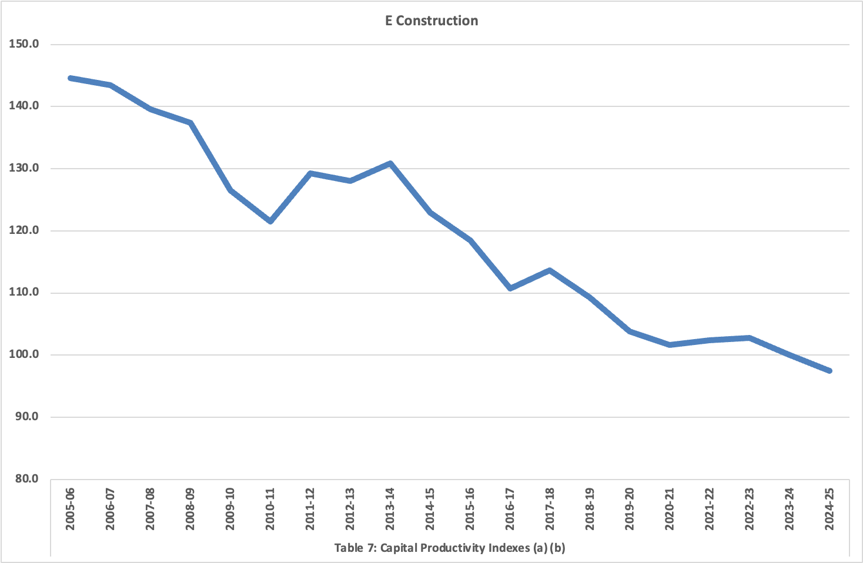
Capital productivity, Construction industry, 2005-06 to 2024-25
Source of data: Australian Bureau of Statistics
5260.0.55.002 Estimates of Industry Multifactor Productivity, Australia
Table 7: Capital Productivity Indexes (a) (b)

Slide 11
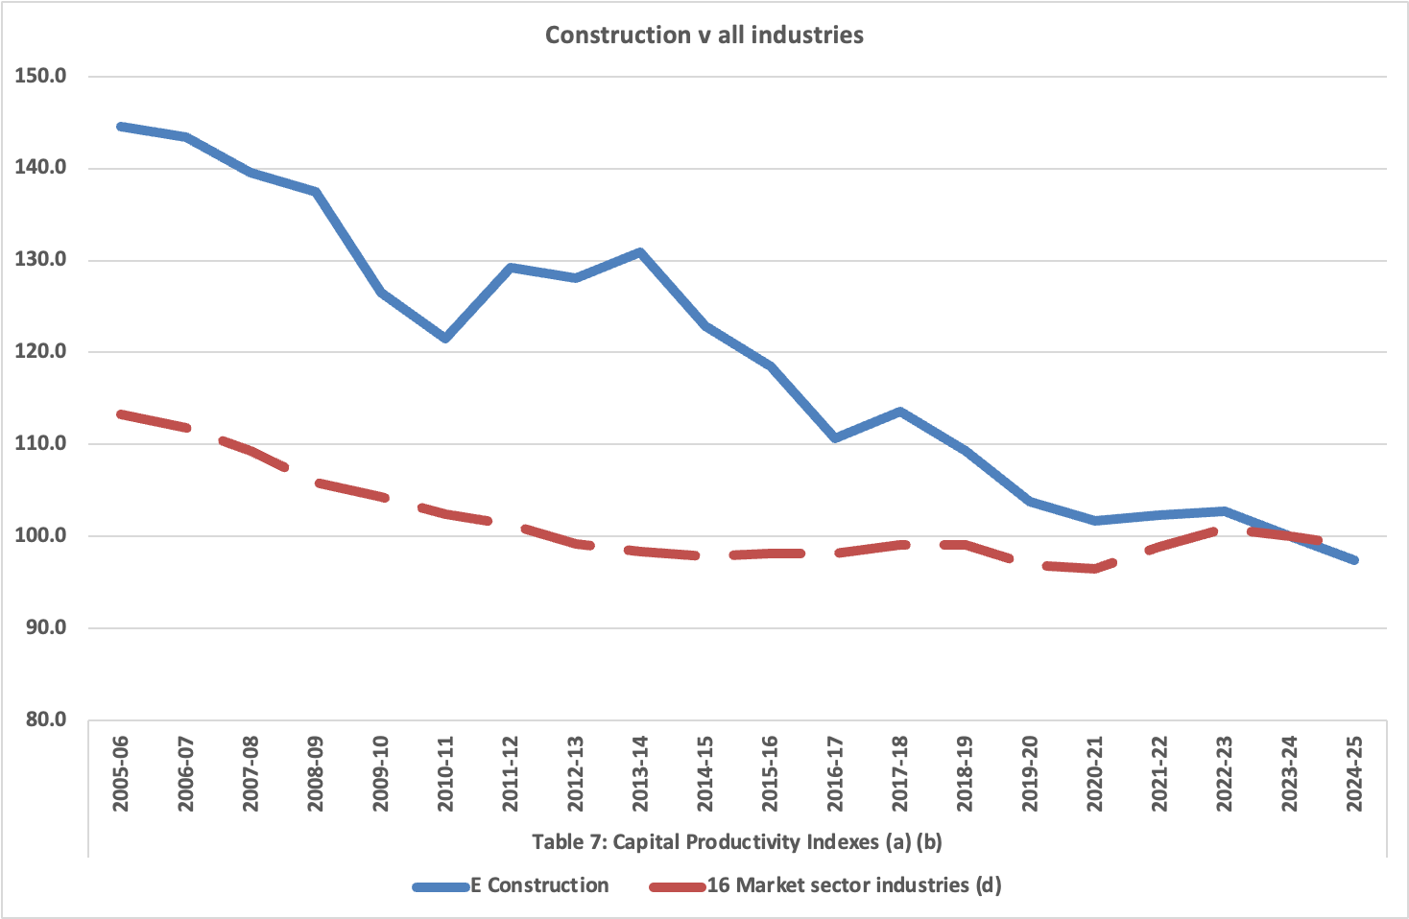
Capital productivity: Construction v 16 Market sector industries, 2005-06 to 2024-25
Source of data: Australian Bureau of Statistics
5260.0.55.002 Estimates of Industry Multifactor Productivity, Australia
Table 7: Capital Productivity Indexes (a) (b)

Slide 12
Multi-factor Productivity

Slide 13
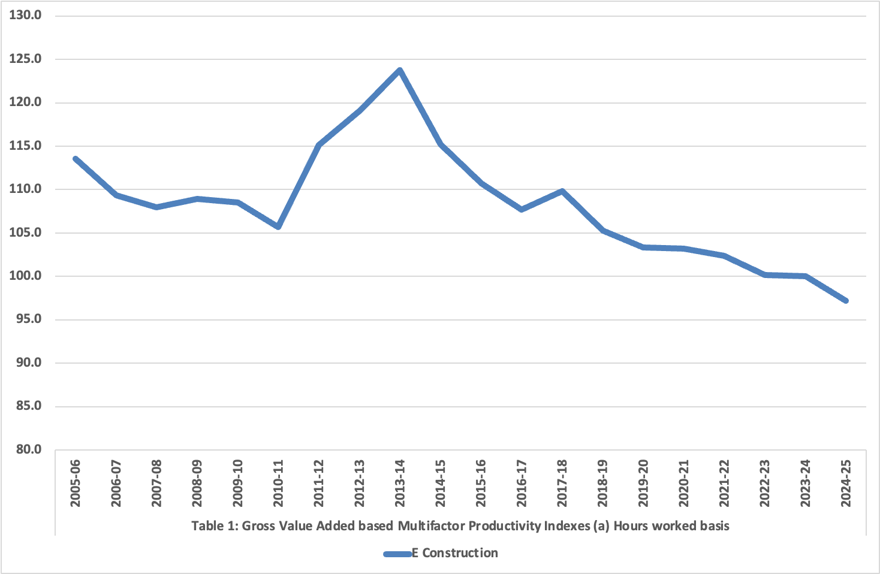
Multi-factor productivity, Construction industry, 2005-06 to 2024-25
Source of data: Australian Bureau of Statistics
5260.0.55.002 Estimates of Industry Multifactor Productivity, Australia
Table 1: Gross Value Added based Multifactor Productivity Indexes (a) (Hours worked basis)

Slide 14
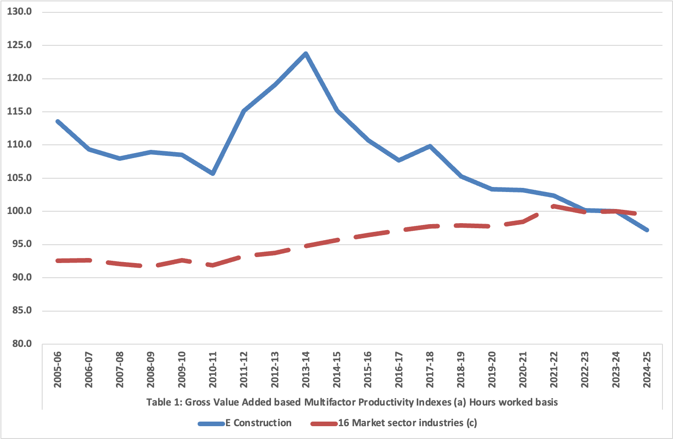
Multi-factor productivity: Construction v 16 Market sector industries, 2005-06 to 2024-25
Source of data: Australian Bureau of Statistics
5260.0.55.002 Estimates of Industry Multifactor Productivity, Australia
Table 1: Gross Value Added based Multifactor Productivity Indexes (a) (Hours worked basis)

Slide 15
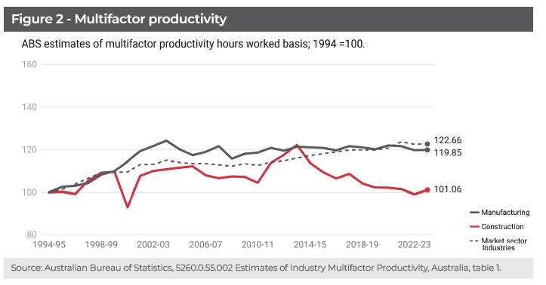
Source: Melissa Wilson & James Brooks, ‘Size Matters, Why Construction Productivity is So Weak’, Committee for the Economic Development of Australia (CEDA), presented at joint Australian Bureau of Statistics & Reserve Bank of Australia conference, Opening Doors: Data and Analytics Shedding Light on Housing Challenges, Sydney, 23–24 June 2025, p 6

Slide 16
Workplace Safety

Slide 17
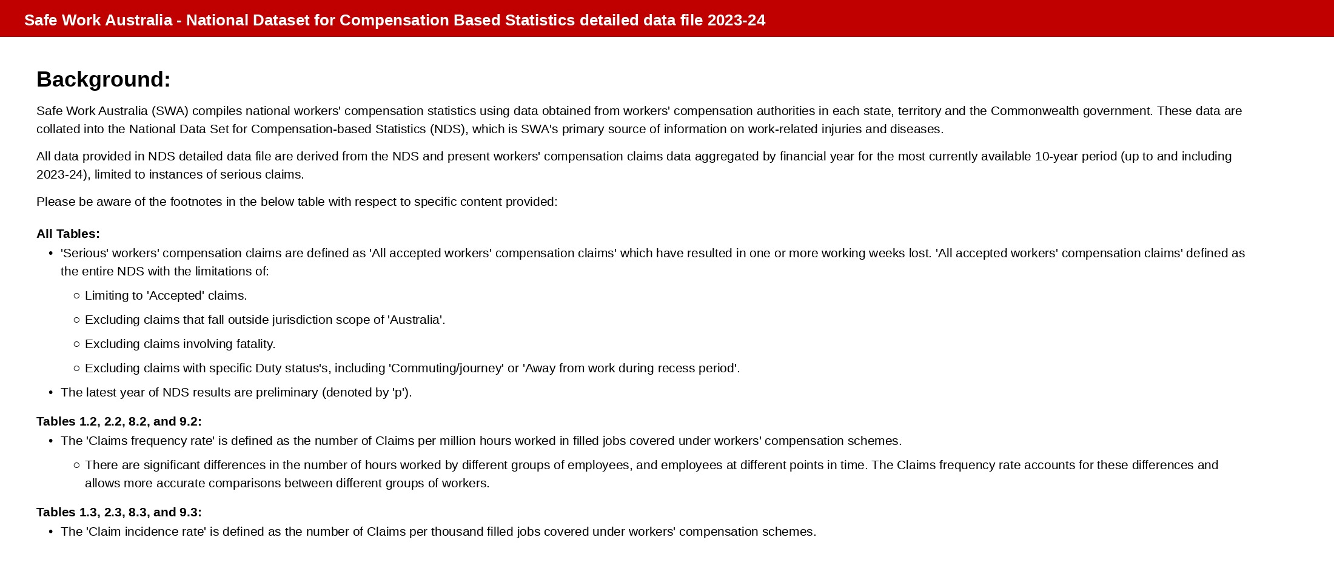
Safe Work Australia NDS - methodology (cover page extract)
Source: Safe Work Australia, National Dataset for Compensation-based Statistics - detailed data file, 2023-24

Slide 18
Table 1.1: Construction industry - number of serious claims, 2014-15 to 2023-24
Claims (count) - Construction (ANZSIC Division E)
Year | Serious claims (number)
2014-15 | 12,397
2015-16 | 12,753
2016-17 | 12,958
2017-18 | 13,834
2018-19 | 14,429
2019-20 | 15,438
2020-21 | 16,077
2021-22 | 16,101
2022-23 | 17,156
2023-24p | 17,609
ANZSIC = Australian and New Zealand Standard Industrial Classification. Used by SWA to record "the range of economic activities undertaken by a business to produce goods and services" (item 8 cover page).
Division E in ANZSIC = Construction industry. ANZSIC sub-divisions: 30 Building Construction; 31 Heavy and Civil Engineering Construction; 32 Construction Services.
Source for Division E definition: ABS ANZSIC classification (linked from item 8 cover page).
Source: Safe Work Australia, National Dataset for Compensation-based Statistics - detailed data file, 2023-24, Table 1.1

Slide 19
Tables 1.2 and 1.3: Construction industry - claims frequency and incidence rates
Construction (ANZSIC Division E)
Year | Frequency rate | Incidence rate
2014-15 | 7.9 | 15.6
2015-16 | 8.0 | 16.0
2016-17 | 7.8 | 15.5
2017-18 | 7.5 | 14.9
2018-19 | 7.7 | 15.4
2019-20 | 8.4 | 16.2
2020-21 | 8.8 | 16.8
2021-22 | 10.5 | 19.8
2022-23 | 9.0 | 17.7
2023-24p | 9.3 | 17.7
Frequency rate (SWA, item 8 cover page):
"The 'Claims frequency rate' is defined as the number of Claims per million hours worked in filled jobs covered under workers' compensation schemes."
Incidence rate (SWA, item 8 cover page):
"The 'Claim incidence rate' is defined as the number of Claims per thousand filled jobs covered under workers' compensation schemes."
COVID-19
Source: Safe Work Australia, National Dataset for Compensation-based Statistics - detailed data file, 2023-24, Tables 1.2 and 1.3

Slide 20
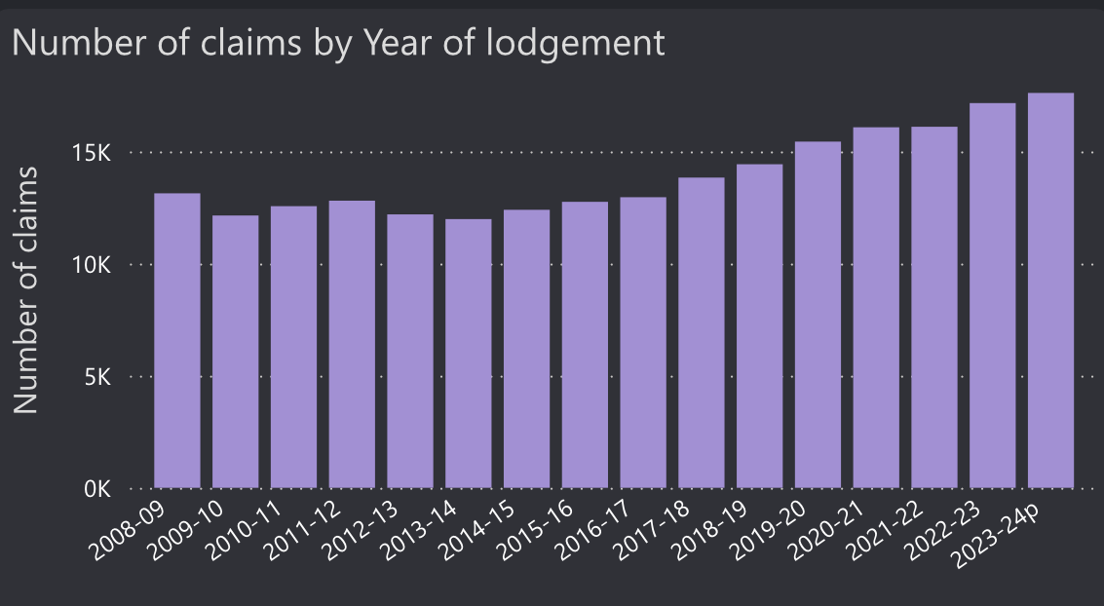
Construction industry: Number of serious workers' compensation claims by year of lodgement,
2008-09 to 2023-24
Source: Safework Australia
https://data.safeworkaustralia.gov.au/interactive-data/topic/workers-compensation

Slide 21
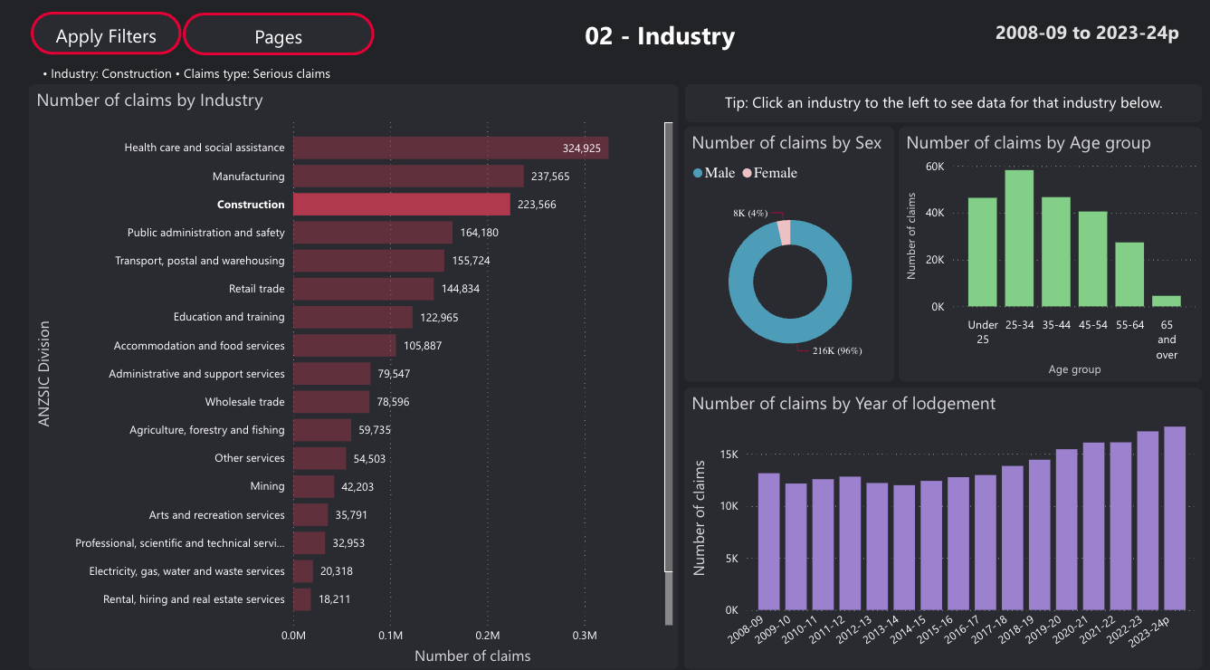
Source: Safework Australia
https://data.safeworkaustralia.gov.au/interactive-data/topic/workers-compensation

Slide 22
Sources
Productivity data
Australian Bureau of Statistics, Estimates of Industry Multifactor Productivity, Australia, 2024-25 (Catalogue 5260.0.55.002), released 6 February 2026. Data file: Tables 1 to 19, downloaded from https://www.abs.gov.au/statistics/industry/industry-overview/estimates-industry-multifactor-productivity/latest-release
Melissa Wilson & James Brooks, ‘Size Matters, Why Construction Productivity is So Weak’, Committee for the Economic Development of Australia (CEDA), presented at joint Australian Bureau of Statistics & Reserve Bank of Australia conference, Opening Doors: Data and Analytics Shedding Light on Housing Challenges, Sydney, 23–24 June 2025
Safety data
Safe Work Australia, Workers' Compensation interactive dataset, available at https://data.safeworkaustralia.gov.au/interactive-data/topic/workers-compensation

